Slide 1



Department of Computer Science and Engineering
GE19612 – PRIEE
A WEB BASED APPROACH TO DETECT RANSOMWARE ATTACKS
Harish D-210701073
Harish S-210701077
Kumaravel V-210701127

Slide 2
Problem Statement and Motivation
Increasing prevalence of ransomware attacks targeting individuals and organizations during file downloads.
Lack of real-time, accessible, and scalable solutions for detecting ransomware threats across different platforms and devices.
Existing methods may struggle with identifying zero-day attacks and providing timely interventions to minimize data loss and damage
Traditional ransomware detection methods are often limited by the need for individual software installations and frequent updates, reducing efficiency and adaptability.
Department of Computer Science and Engineering
2

Slide 3
Objectives
Develop a Chrome extension using HTML, CSS, and JavaScript to detect ransomware threats during file downloads by analyzing file extensions and signatures
Provide real-time warnings and options to discard or save downloaded files based on the detection of potentially malicious activity.
Ensure seamless integration with the Chrome browser and minimal impact on browsing performance through efficient coding practices.
Offer a cloud-based, scalable solution accessible across various platforms, simplifying deployment and maintenance while enhancing overall cybersecurity
Department of Computer Science and Engineering
3

Slide 4
Abstract
Real-Time Detection: This project proposes a web-based system, specifically a Chrome extension, built with HTML, CSS, and JavaScript to detect ransomware threats during file downloads, providing real-time warnings and allowing for timely intervention to minimize data loss.
Multi-Layered Architecture: The system leverages advanced techniques and a multi-layered architecture to identify malicious activity, offering enhanced adaptability to new threats compared to traditional methods, and integrates seamlessly with the Chrome download process.
User-Friendly and Accessible: By analyzing file extensions and using pre-defined rules or lightweight databases, the extension provides a user-friendly interface that offers real-time warnings and options to discard or save files, ensuring minimal impact on browsing performance
Department of Computer Science and Engineering
4

Slide 5
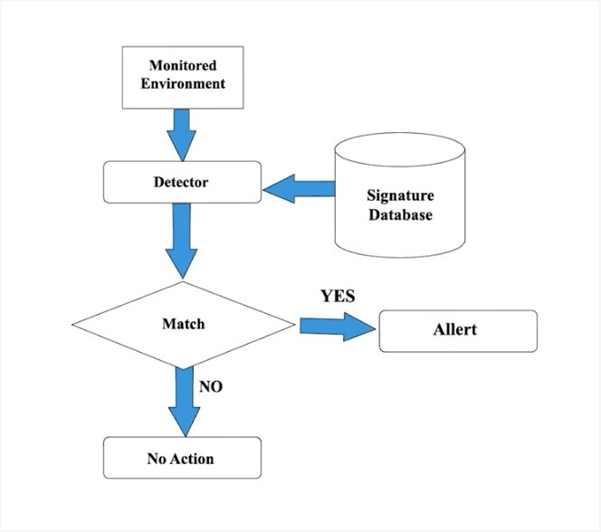
System Architecture
Detection Process: The monitored environment feeds data into a detector that checks for suspicious activities.
Signature Matching: The detector references a signature database to identify potential threats. If a match is found, an alert is triggered.
Action Decision: If no match is found, no action is taken; otherwise, the system issues an alert to inform users of the potential threat.
Department of Computer Science and Engineering
5

Slide 6
List of Modules
USER MODULE:
The "Malware Detection Module" for Chrome is designed to protect users from malicious software during file downloads. This module integrates seamlessly with the Chrome browser, continuously monitoring all incoming downloads in real-time. Utilizing advanced detection techniques such as behavior analysis, heuristic scanning, and cloud-based threat intelligence, it identifies and blocks potential malware before it can infect the user's system. The module alerts users immediately upon detecting suspicious files, providing options to quarantine or delete the threats. This proactive defense mechanism ensures a secure browsing and downloading experience, safeguarding users against a wide range of malware threats.
Department of Computer Science and Engineering
6

Slide 7
List of Modules
MALWARE DETECTION FOR CHROME DOWNLOADS
This module is designed to enhance the security of Chrome browser downloads by detecting malware files in real-time. It leverages advanced detection techniques to ensure that any potentially harmful files are identified before they can impact the user's system. The module is divided into several key components, each responsible for a specific aspect of the detection process.
REAL TIME SCANNING ENGINE
he core of the malware detection module, this engine continuously monitors downloads in Chrome. It uses a combination of signature-based and heuristic-based detection methods to identify known malware and potential threats based on file behavior and characteristics.
Department of Computer Science and Engineering
7

Slide 8
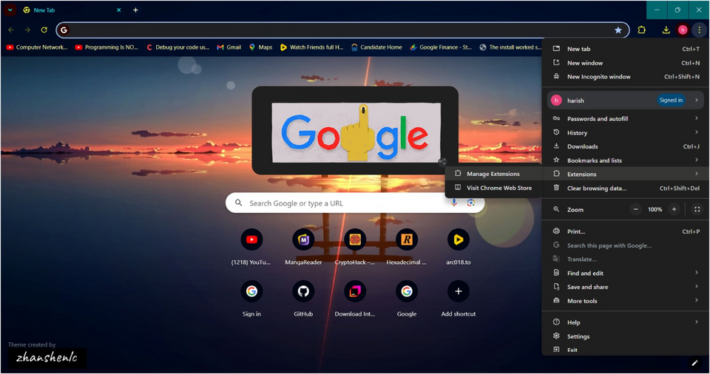
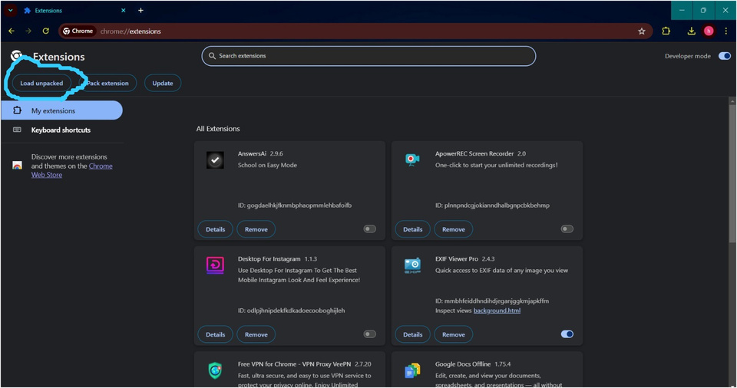

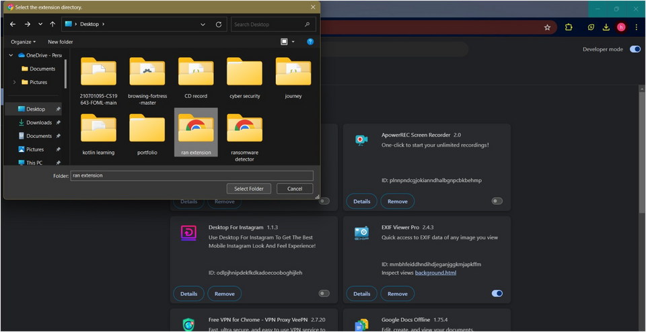
Implementation/Results of Module
Department of Computer Science and Engineering
8

Slide 9
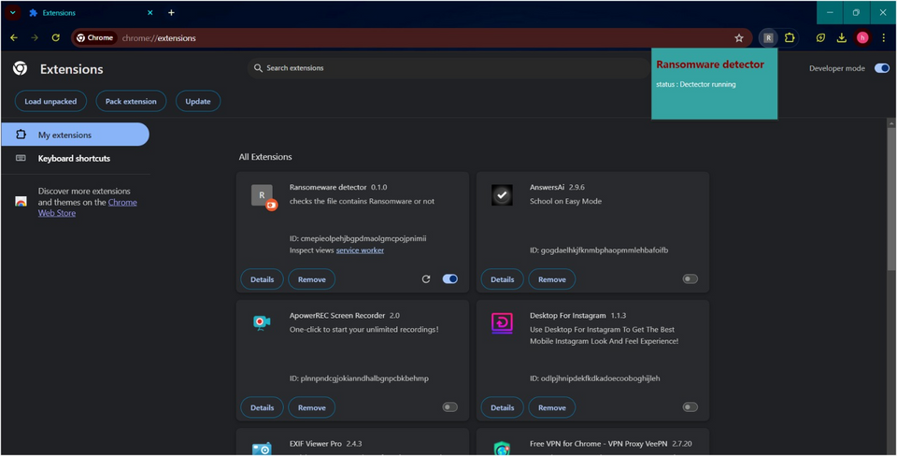
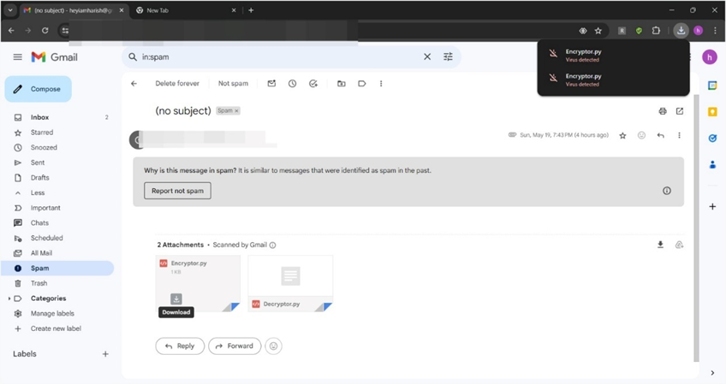
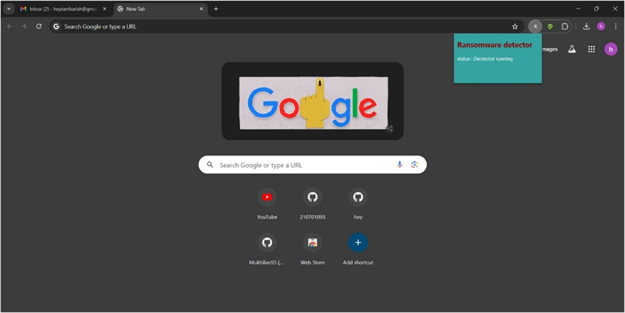
Implementation/Results of Module
Department of Computer Science and Engineering
9

Slide 10
Implementation/Results of Module
This project tackles the evolving threat of ransomware with a user-centric Chrome extension built using HTML, CSS, and JavaScript. Seamlessly integrating with Chrome's download process, it analyzes files in real-time, detecting suspicious patterns indicative of ransomware. Upon detection, it promptly alerts users with a clear warning, empowering them to make informed decisions. By proactively identifying threats, the extension aims to reduce data loss and disruptions, enhancing cyber defenses for both individuals and organizations and fostering a safer online environment.
Department of Computer Science and Engineering
10

Slide 11
Conclusion
Integrated Real-Time Threat Detection: The Chrome extension seamlessly integrates with the download process, leveraging HTML, CSS, and JavaScript to analyze files in real-time, identifying patterns indicative of ransomware and providing immediate warnings to users.
Proactive Cyber Defense: By detecting and warning about potential threats before they can cause harm, the extension significantly reduces the risk of data loss and disruption, benefiting both individual users and organizations.
Fostering a Safer Online Environment: Beyond its technical capabilities, the extension’s core philosophy of user empowerment promotes a culture of cybersecurity awareness, equipping users with the knowledge to recognize and avoid malicious files, thus strengthening overall cyber defenses.
Department of Computer Science and Engineering
11

Slide 12
References
[1] [1]A Study on Malware and Malware Detection Techniques. 19th Decemeber 2017, Rabia Tahir
[2] [1]A Machine Learning Approach to Android Malware Detection, Justin Sahs; Latifur Khan, 24th August 2012
[3] [1]Semantics-aware malware detection, M. Christodorescu; S. Jha; S.A. Seshia; D. Song; R.E. Bryant, 08-11 May 2005.
[4] A Review of Android Malware Detection Approaches Based on Machine Learning, Kaijun Liu; Shengwei Xu; Guoai Xu; Miao Zhang; Dawei Sun; Haifeng Liu, 01 July 2020
Department of Computer Science and Engineering
12

Slide 13
Github Link
Github Link:
Department of Computer Science and Engineering
13

Slide 14
Thank You
Department of Computer Science and Engineering
14

